Slide 1

DEPARTMENT OF COMPUTER ENGINEERING
Inclusive Learn (Group no 4)
Student name: Jainam Gala Roll no: 42 Division: A
Student name: Nikita Dung Roll no: 40 Division: A
Student name: Swamini Chaudhari Roll no: 22 Division: A
Student name: Akshaykumar Jain Roll no: 62 Division: A
Under the Guidance of Prof. Merlin Priya Jacob

Slide 2
Problem statement
Objective
The extend of how the pandemic have upended students’ lives are manifold, but some bear the brunt more than the others. Disabled students have faced unique challenges to their academic journey throughout the pandemic. It has been researched that to comply with the lockdown restrictions various university management excluded the minority group of students with disabilities while focusing on e-learning. Due to this there were several challenges encountered by the disabled students while using e-learning platforms like accessing and navigating the platform, audio content, sign language interpretation, difficulty while using a computer or a device and they may require additional assistance.
The main objective of our platform is to provide equal educational opportunities to all learners, regardless of their abilities
To offer a wide range of interactive and engaging educational content, including questionnaires and quizzes to cater to different learning styles.
To include assistive technology like closed captioning, audio descriptions, object detection and sign language interpretation to make content accessible to all learners.
To offer a safe and inclusive environment that is dedicated to breaking down barriers and creating a world where all children have equal access to education & the tools they need to reach their full potential.
Inclusive Learn

Slide 3
Scope and Features
Accessibility: Inclusive Learn aims to make education accessible to individuals with diverse abilities, including the deaf and hard-of-hearing communities, by incorporating Hand Gesture Recognition for Sign Language Detection. This module allows users to communicate using sign language and interact with the e-learning platform effectively.
Interactive Learning: The Live Object Detection module using YOLO v5 enhances the e-learning experience by providing real-time object detection capabilities. This feature can be utilized in various educational scenarios, such as identifying objects in science experiments, geography maps, or historical artifacts, making learning engaging and interactive.
Versatility: Inclusive Learn's modular design allows for flexibility and scalability. The three modules - Hand Gesture Recognition, Live Object Detection, and Intelligent Voice Assistant - can be used individually or in combination, providing a versatile e-learning platform that can be tailored to different educational contexts and requirements.
Personalized Assistance: The Intelligent Voice Assistant module using Whisper.ai and ChatGPT offers personalized assistance to learners. Users can interact with the voice assistant to ask questions, get clarifications, or receive additional information, creating a dynamic and interactive learning environment tailored to individual needs.
Real-Time Feedback: Inclusive Learn provides real-time feedback to learners using Hand Gesture Recognition and Live Object Detection modules. Users can receive instant feedback on their sign language gestures or object identification skills, allowing them to correct mistakes and improve their learning progress.
User-Friendly Interface: The platform offers a user-friendly interface that is easy to navigate and interact with, making it accessible to learners of all ages and abilities. The interface is designed to accommodate different learning styles, including visual, auditory, and kinesthetic, to ensure an inclusive learning experience for all.

Slide 4
Implemetation Technology
Frontend Technologies:
HTML
CSS
Javascript
Backend Technologies:
Flask
Gradio
Machine Learning:
Python
ML libraries: scikit learn, pandas, numpy, matplotlib, opencv, tensorflow, mediapipe
Inclusive Learn

Slide 5
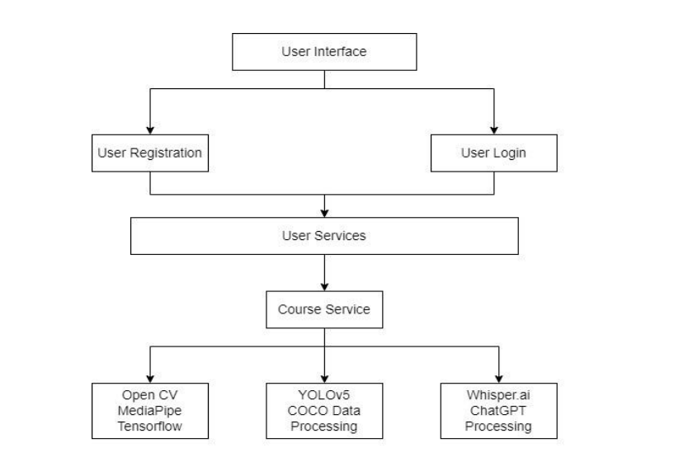
ARCHITECTURE DIAGRAM
Inclusive Learn

Slide 6
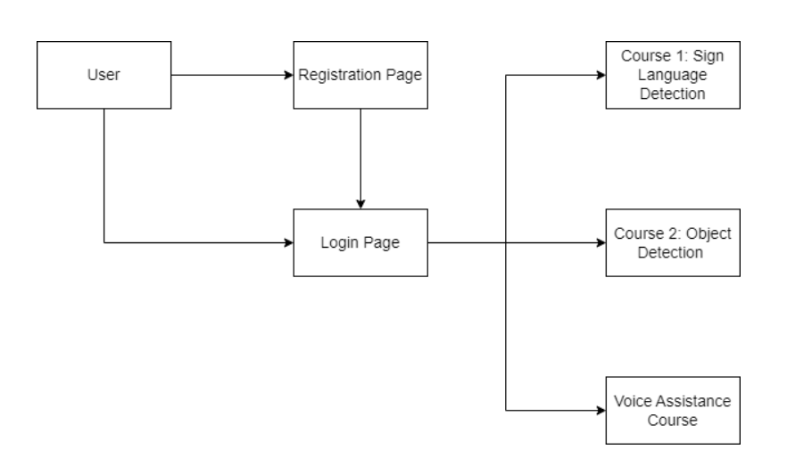
DFD LEVEL 0
Inclusive Learn

Slide 7
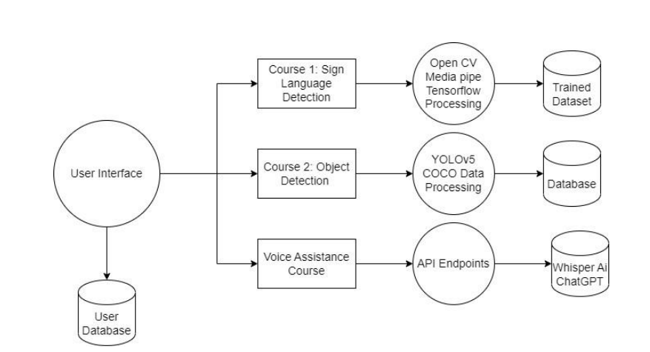
DFD LEVEL 1
Inclusive Learn

Slide 8
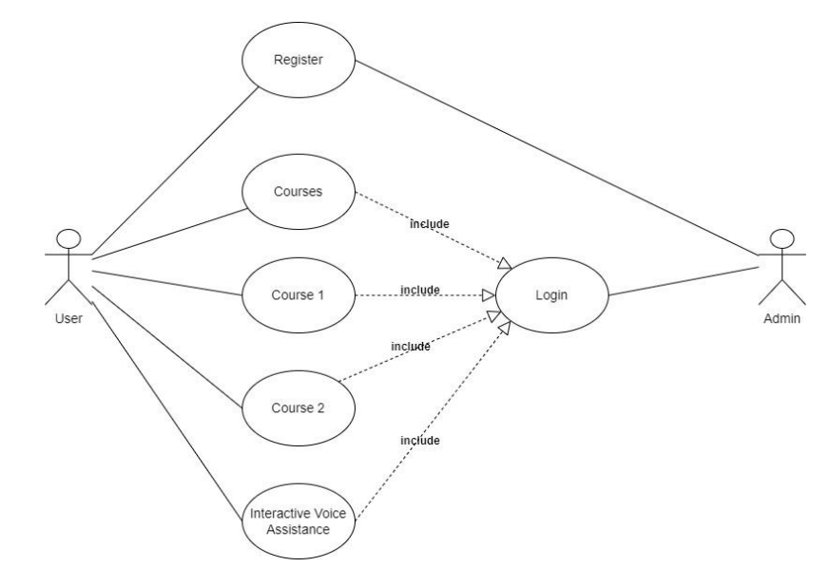
USE CASE DIAGRAM
Inclusive Learn

Slide 9
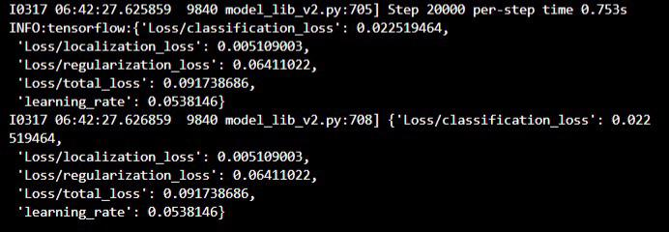
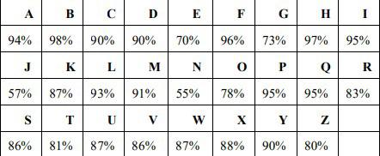
Model Output Metrics
Inclusive Learn

Slide 10
Modules
Course 1 – Hand Gesture Recognition for Sign Language Detection Using MediaPipe Hands
Hand Gesture Recognition for Sign Language Detection Using MediaPipe Hands is a cutting-edge technology that combines computer vision and machine learning to interpret hand gestures used in sign language. MediaPipe Hands is a powerful hand tracking library developed by Google that can accurately detect and track hand landmarks in real-time video streams. This technology utilizes deep learning algorithms to analyze the position, orientation, and movement of the hand landmarks to recognize various sign language gestures.
Course 2 – Live Object Detection Using YOLO v5
Live Object Detection using YOLO v5 is a state-of-the-art computer vision technology that allows real-time detection and localization of objects in video streams. YOLO (You Only Look Once) v5 is a popular and highly efficient object detection algorithm that uses deep neural networks to detect objects in images and videos with remarkable accuracy and speed. With its advanced architecture, YOLO v5 is capable of detecting multiple objects simultaneously, even in complex scenes, making it ideal for real-time applications.
Intelligent Voice Assitant Using Whisper.ai and ChatGPT
An Intelligent Voice Assistant using Whisper.ai and ChatGPT combine the power of two advanced technologies to create a seamless voice-controlled conversational experience. Whisper.ai is an automatic speech recognition (ASR) system developed by OpenAI that leverages deep learning to accurately transcribe spoken language into text. ChatGPT, on the other hand, is a large language model that can generate human-like responses in a conversational manner.
Inclusive Learn

Slide 11
References 1
S. Paramasivam, I. A. Krishnan, A. S. Amin, N. Kaliappen, R. S. Sidhu, and H. Anbalagan, “Challenges Faced by Disabled Students in Online Learning during the COVID-19 Pandemic,” International Journal of Academic Research in Business and Social Sciences, vol. 12, no. 1, Jan. 2022, doi: https://doi.org/10.6007/ijarbss/v12-i1/12282.
‌
Inclusive Learn

Slide 12
References 2
O. A. Denisova, O. L. Lekhanova, and T. V. Gudina, “Problems of distance learning for students with disabilities in a pandemic,” SHS Web of Conferences, vol. 87, p. 00044, 2020, doi: https://doi.org/10.1051/shsconf/20208700044.
Inclusive Learn

Slide 13
References 3
“Exploring the impact of Covid-19 on disabled students’ experiences Published by Advance HE on behalf of the Disabled Students’ Commission. Exploring the impact of Covid-19 on disabled students’ experiences Disabled Students’ Commission 2.” Available: https://s3.eu-west-2.amazonaws.com/assets.creode.advancehe-document-manager/documents/advance-he/DSC_Impact%20of%20Covid19_student%20experience_1628763062.pdf
‌
Inclusive Learn

Slide 14
References 4
H. Hashim and S. Khadijah, “E-LEARNING ENVIRONMENT FOR HEARING IMPAIRED STUDENTS,” The Turkish Online Journal of Educational Technology, vol. 12, no. 4, 2013, Available: https://files.eric.ed.gov/fulltext/EJ1018030.pdf‌
Inclusive Learn

